Slide 1


Module 2 Project:
Evan Holder
Notes:
I am Evan Holder and this is my flatiron end of module 2 project presentation

Slide 2
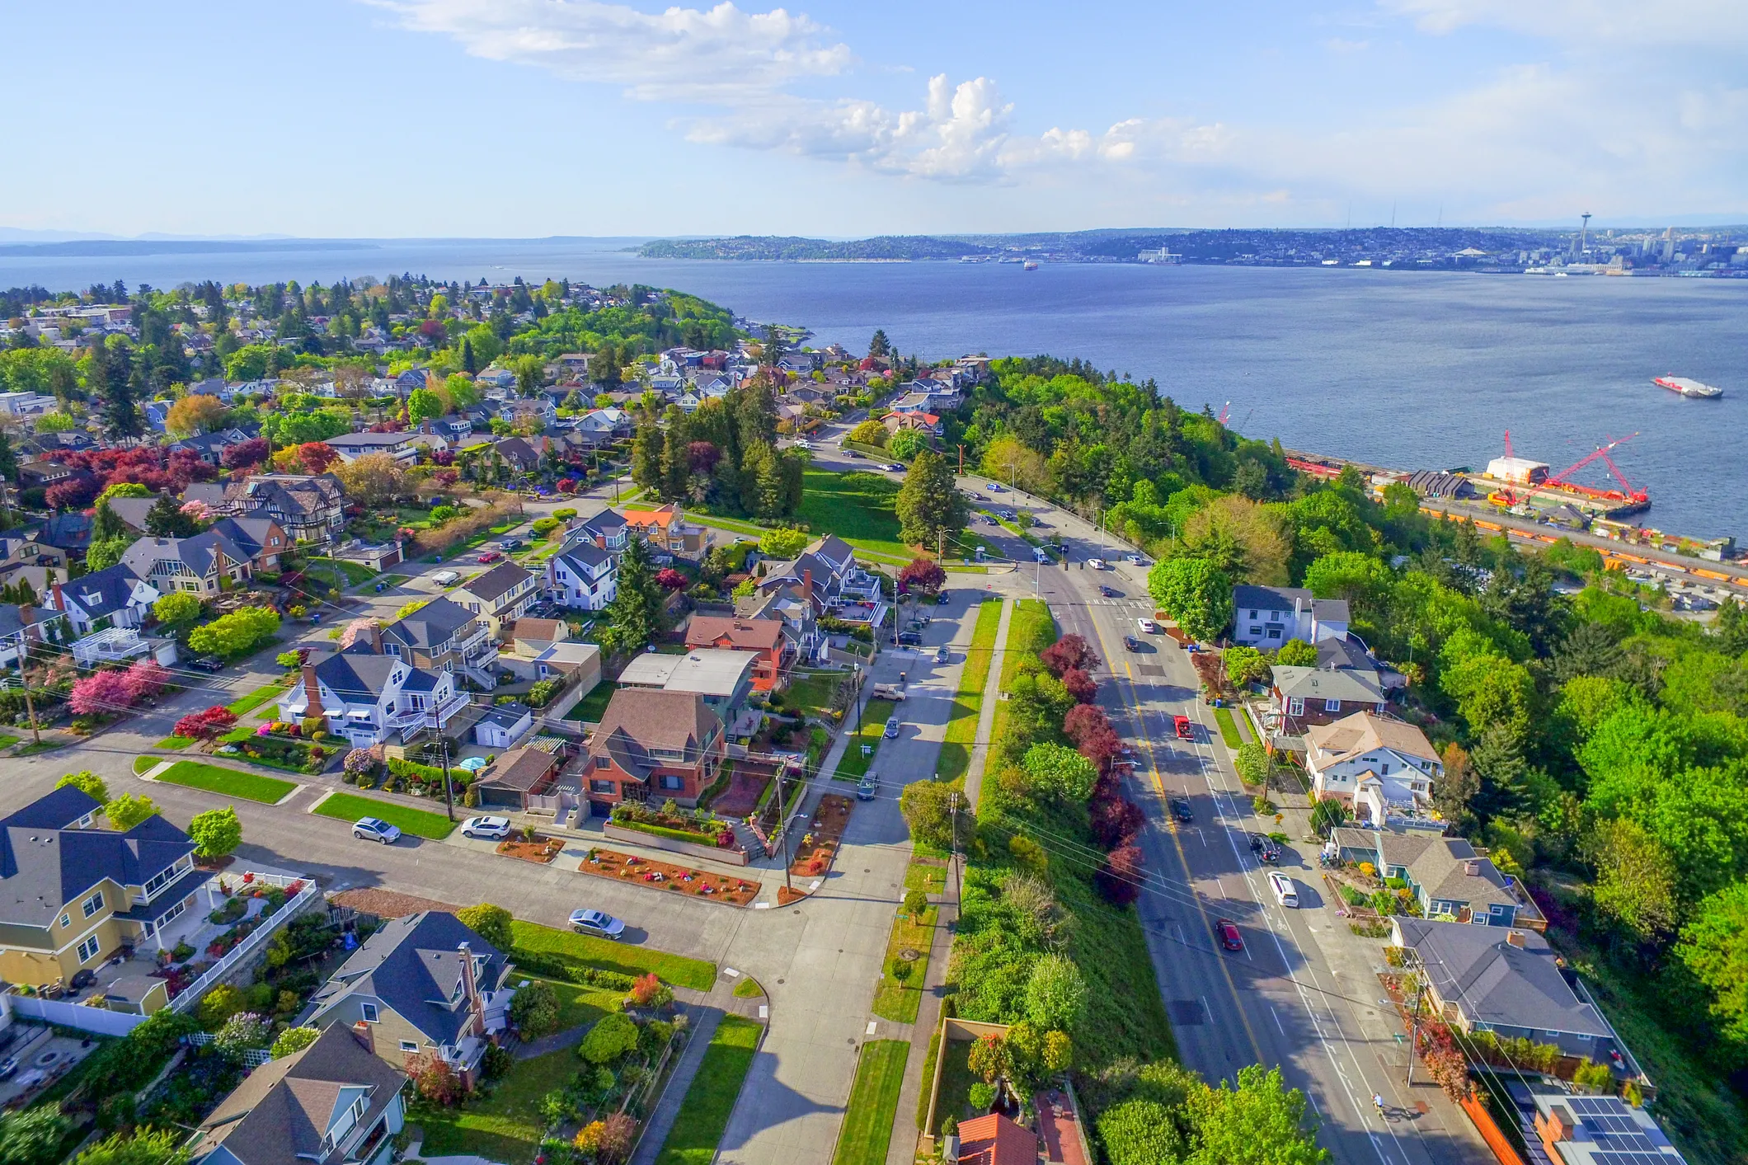

Modeling Housing Prices Around Seattle
Why?
Notes:
According to the 2017 State of the Nation’s Housing report, approximately two-thirds of Americans buy their house rather than rent it. And they don’t always get the best deal. Among homeowners, 10% or 7.6 million, spent more than half their household income on their mortgage. On the flip side however, real estate can be a great investment. The typical U.S. home value rose 11.6 % over the past year according to Zillow, and a record 1.3% last month alone. So how can you buy a house without breaking the bank? We’ve modeled housing prices in Seattle to show you what types of features make a home cost the most, and where you might be to get more bang for your buck.
Link:
https://www.jchs.harvard.edu/state-nations-housing-2017

Slide 3
Approach
Create a model using the King County Housing dataset (Seattle & Seattle metro area)
Answer these questions:
Which housing features drive housing prices?
How can I get the best and worst deals?

Slide 4
The Model: Features
Predictors:
Bedrooms
Bathrooms,
Square feet
Floors
Waterfront
Condition
Grade
Year built
Square feet of nearest 15 neighbors
Renovated
Basement
Zipcode
Outcome Variable : Price

Slide 5
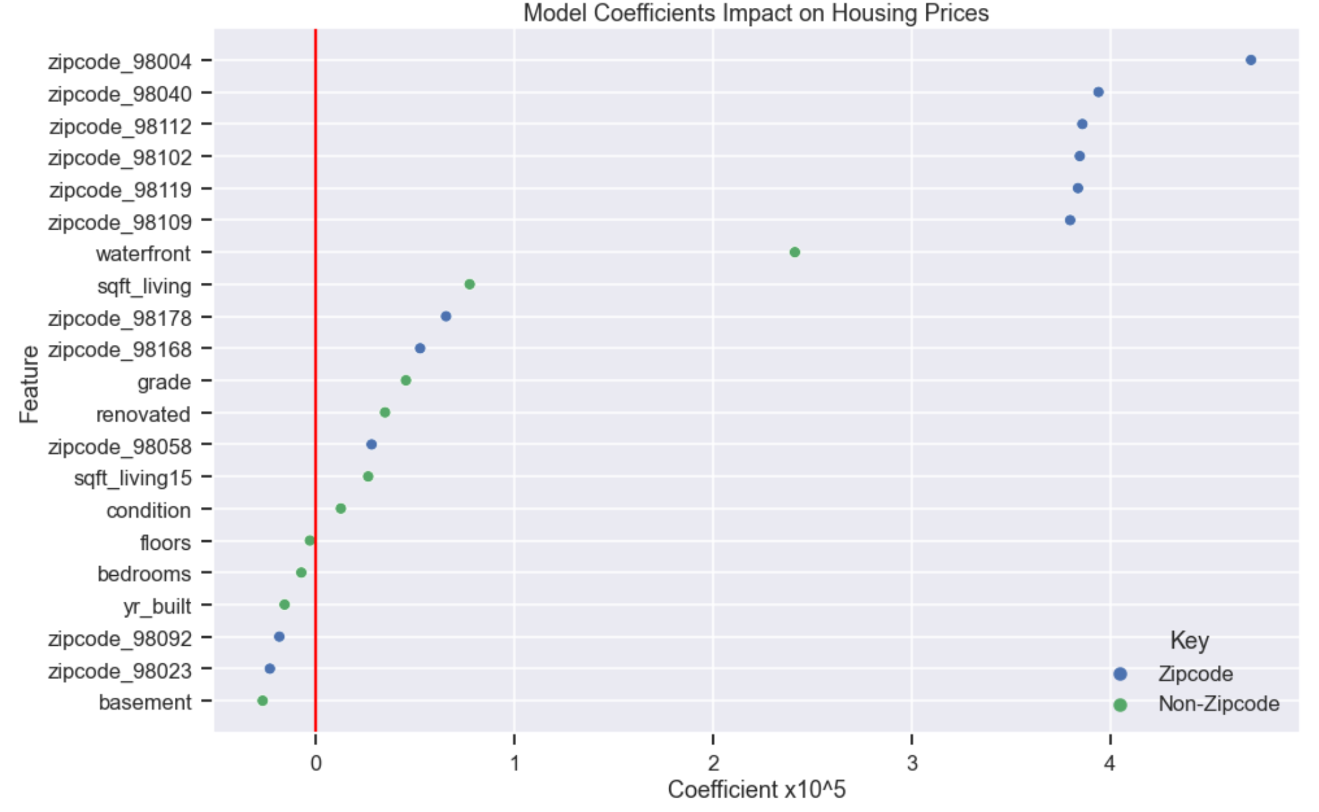
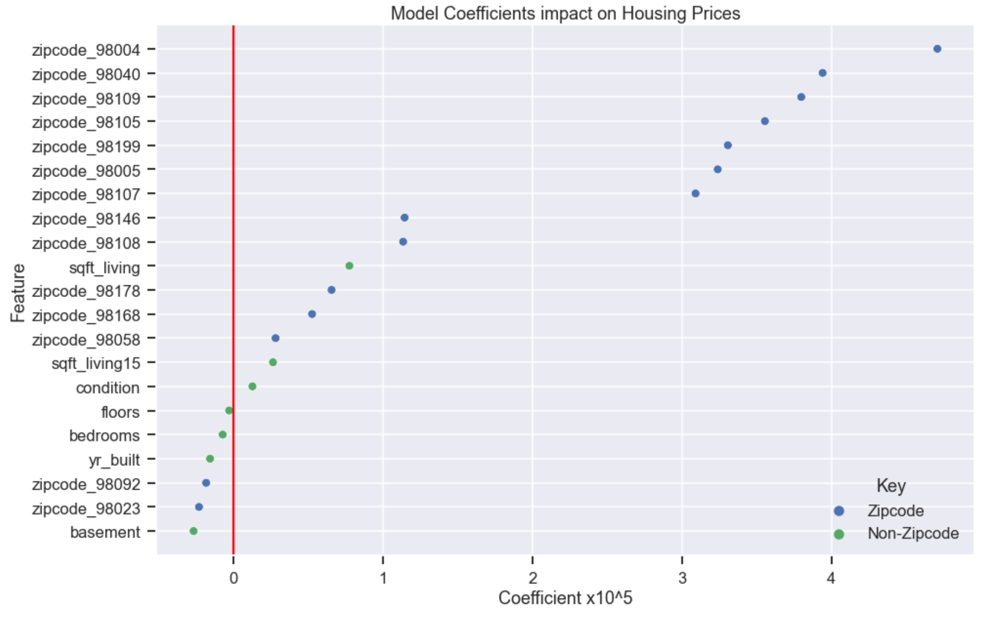
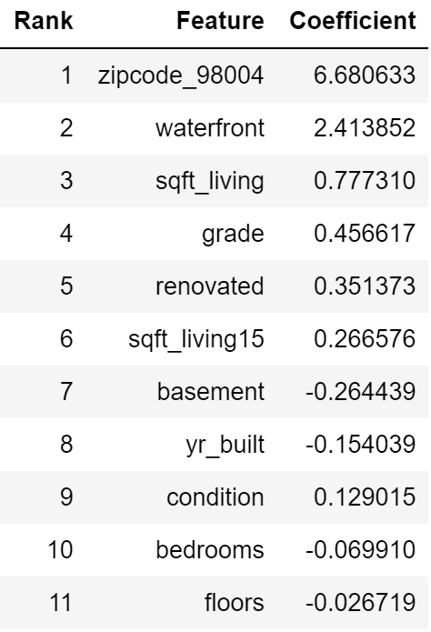
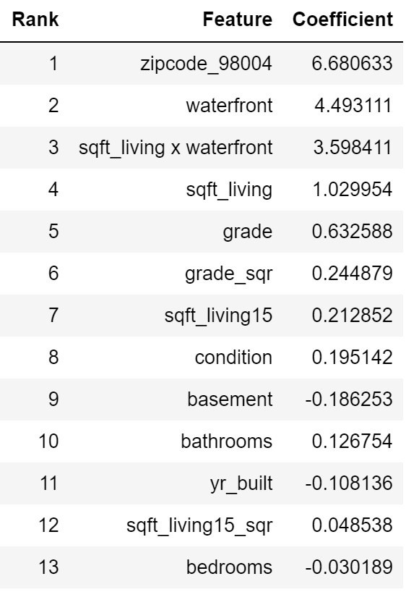
The Model: Driving Features
Notes:
So after cleaning up the data, we ran the model and here are the results. This plot shows each feature and how much it drives the model, either positively or negatively. So the further away the feature (dot) is from zero, our red line, the more impactful it is on housing prices. If its on the right of the red line, it’s positively impacting price, and if its on the left it’s negatively impacting price. To the right, is a list of each feature in order of most impactful. As you can see the most influential features are all zipcodes. And in fact, there were a bunch more zipcodes in the model but I removed them the plot and list as they only clutter them. The next most influential feature on price was whether or not the property is waterfront, and following was the number of square feet of living space. And fourth most important on our list here was the grade the house was assigned. As you go down the you’ll notice that bedrooms actually has a negative value… the model is basically telling us that having more bedrooms would results in a lower price.

Slide 6
The Model: Bedrooms
Notes:
You’d think that more bedrooms would mean a higher price, wouldn’t you? We’ll the model has actually captured a very important point.

Slide 7
The Model: Bedrooms and Sqft
Notes:
Our model understands that increasing square footage of the house also likely increases the number of bedrooms. The two features are not completely independent of each other and are actually very related. And in so doing, the model predicts that a house with say 5000 square feet and 6 bedrooms is worth less than a 5000 square foot house with 3 bedrooms. In essence the model is saying that more spacious houses are worth more (ie more square feet and less bedrooms).

Slide 8
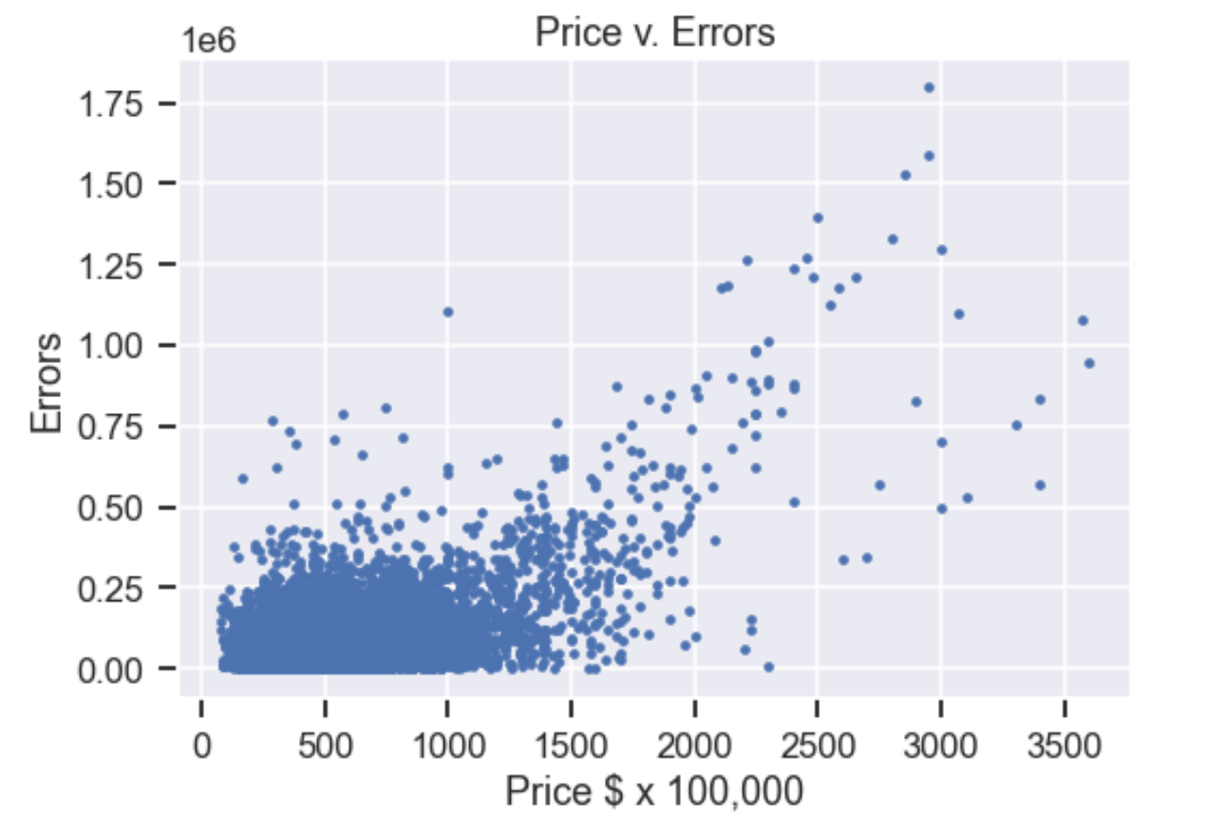
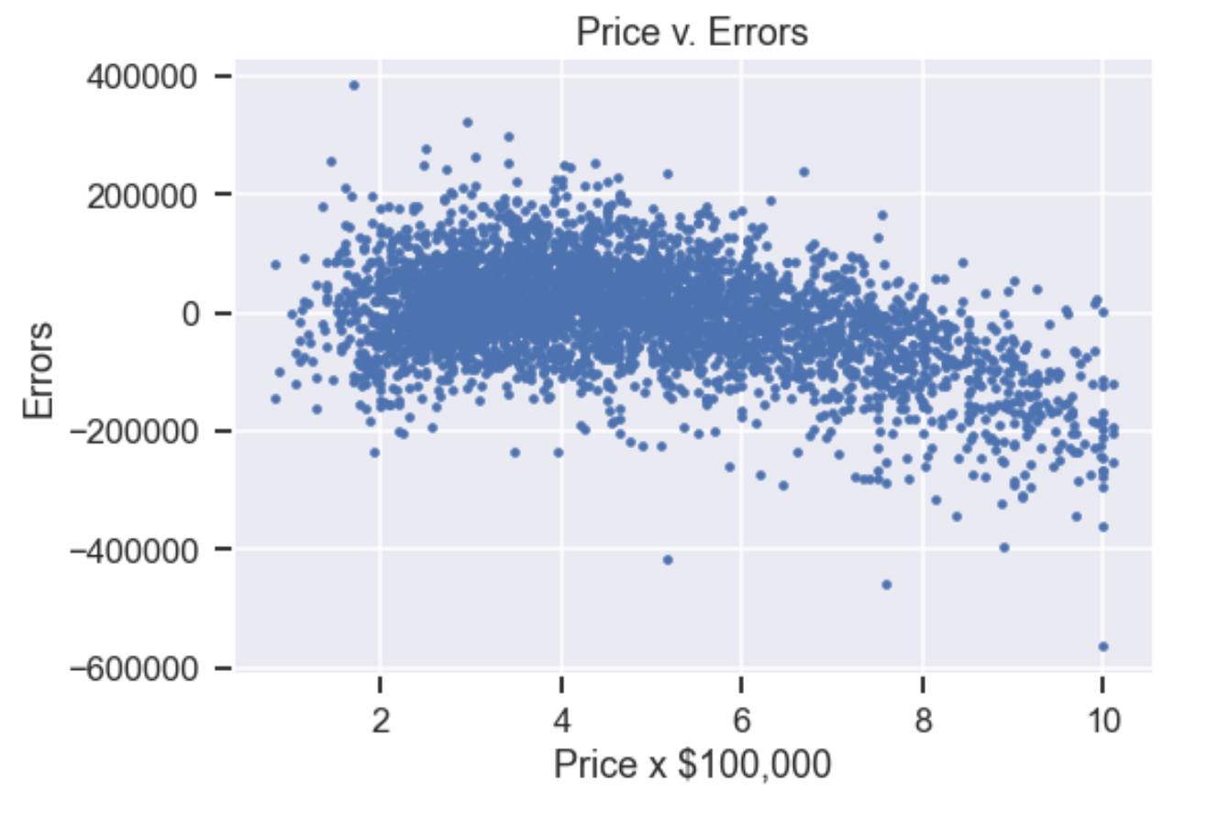
Model: How well does the it fit the data?
“Goodness of fit” = percent of errors that we can explain (R-squared)
Notes:
But how well does the model perform? One way of asking the question is how well does our model fit the data. In statistics, that would be the percentage of variability in price that our predictive features can explain.

Slide 9
Model: How well does the it fit the data?
“Goodness of fit” = percent of errors that we can explain (R-squared)
81%
Notes:
Our model can explain about 81% of the variability in price.

Slide 10
Model: How well does the it fit the data?
“Goodness of fit” = percent of errors that we can explain (R-squared)
81%
Model does not perform well where prices are very high and low.
Notes:
Where the model does not perform well when prices are high and low. We can use this as tool to find where people got the best and worst deals. All we have to do is look at where the actual housing prices were the most different from what the model predicted. If the actual price was low, while the model predicted higher, then that person got a good deal. If the model predicted a lower price than the actual price, then that person got ripped off.

Slide 11
The Model: Best/Worst Deals
Top 100 “best deals” (data points with the most negative errors) v. dataset averages
Square Feet, 15 Closest Neighbors Square Feet, Grade, Renovated, Waterfront
Zipcodes: 98033, 98115, 98118, 98103, 98006
Top 100 “worst deals” (data points with the most positive errors) v. dataset averages
Renovated, Basements, Waterfront
Zipcodes: 98103, 98006, 98033, 98115, 98112, 98177
Common Attributes
Renovated, Waterfront
Zipcodes: 98033, 98006, 98115
Notes:
So using our model we found the datapoints which the 100 most negative errors (where the model predicted housing cost higher than actual prices) and took the difference between their features and the averages of the entire dataset. We found that these cheaper prices homes had more square feet, were located in neighborhoods with properties with more squarefeet, had higher grades, were renovated, and more often waterfront. Also these 100 best deals were located in zipcodes 98033, 98115, 98118, 98103, 98006
In the same way we found the datapoints with the 100 most positive errors (where the model predicted housing cost lower than actual prices) and found that these more expensive homes were more often renovated, had basements, and were waterfront. These overpriced homes were located in Zipcodes: 98103, 98006, 98033, 98115, 98112, 98177
Common attributes: Some features were common to the 100 best and worst deals, these included renovated, and waterfront house, and houses in Zipcodes: 98033, 98006, 98115. It‘s important to note that these features occur in houses grossly over and underpriced and so should be considered more carefully when making a purchase.

Slide 12
Summary / Recommendations
The most important indicator of housing prices is location
If you are looking for a good price on a house, look for something with a lot of square feet and but yet fewer bedrooms, avoid waterfront properties or any properties that have been newly renovated
Future Work
Expand the model to include data from larger geographical regions.
Notes:
Summary: The model would greatly benefit from an expansion of data outside of the Seattle area.
For Future work:
This model is very specific to the Seattle metro area where there is a real mix of city, suburban, and rural, but may not perform well in the inner city neighborhoods or in very rural parts of the United States.

Slide 13
The End
Any questions?

